Slide 1

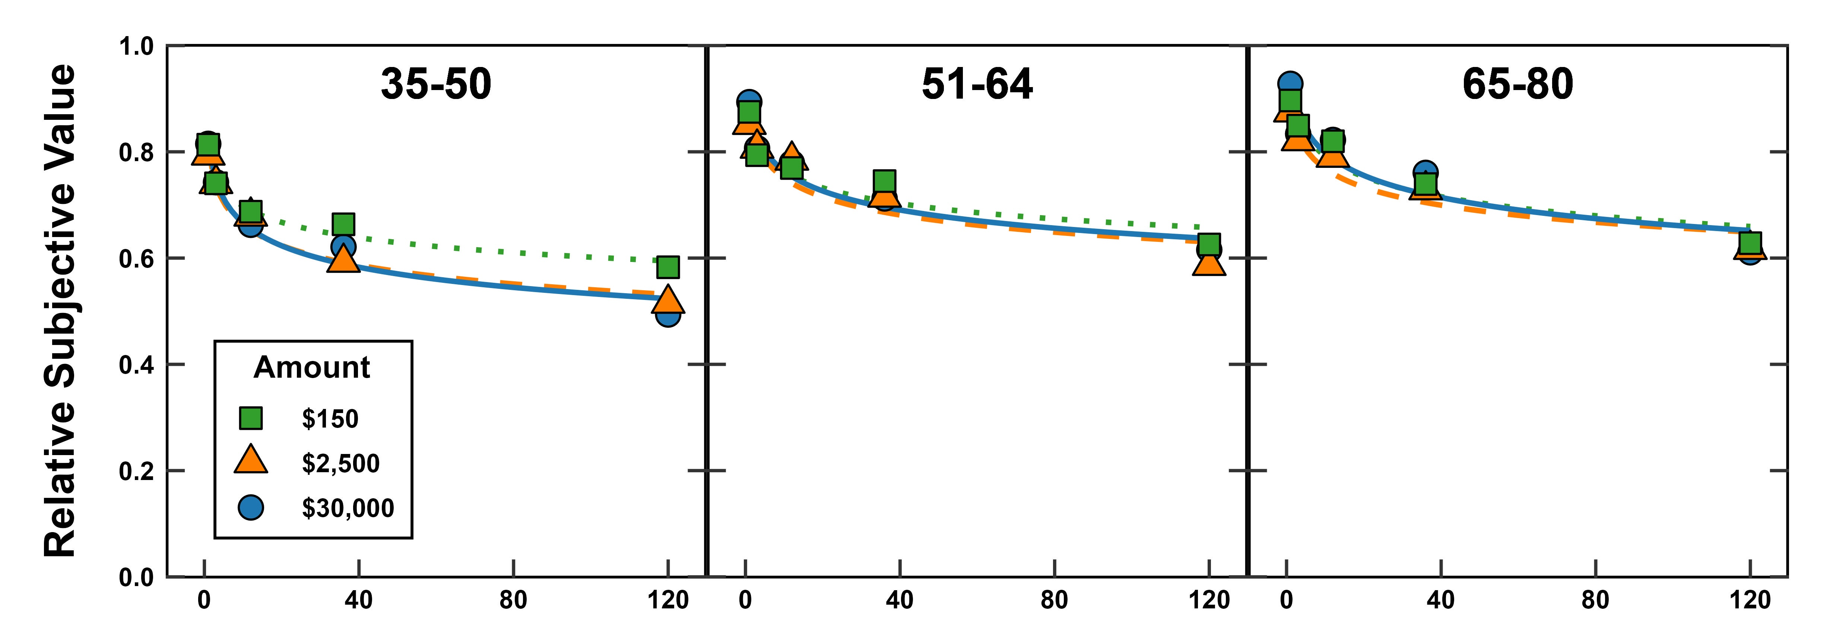
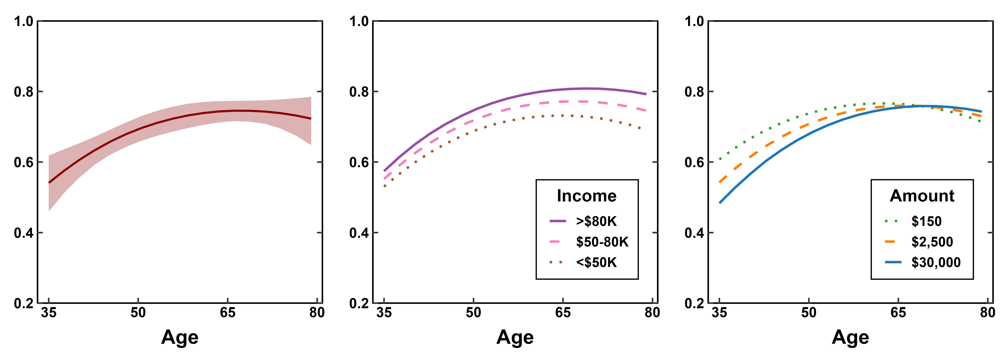
Age, Income, and the Discounting of Delayed Monetary Losses
Haoran Wan, Leonard Green, Joel Myerson, Michael J Strube, Sandra Hale, & Dora Chen
Introduction
Results
A meta-analysis by Seaman et al. (2022) found little effect of age on the discounting of delayed rewards, but they acknowledged that a limitation was they could not assess effects of socioeconomic status.
Our recent study (Wan et. al., 2024) compared younger and older adults with lower and higher incomes and found clear age differences in those with lower incomes but not those with higher incomes.
Nearly all of the studies of age-related differences in delay discounting involved gains but not losses.
The few studies that did examine the discounting of delayed losses failed to reveal age differences, but these studies did not account for possible moderation effects of income, and the amounts studied were small (≤ $100).
Accordingly, the present study assessed age- and income-related differences in the degree to which adults discount delayed losses of varying amounts.
Hyperboloid discounting functions described the systematic decrease in Relative Subjective Value
as a function of Delay
(all R² > .87), in each age of the three age groups.
Delay (months)
A. Age Effect
B. Age x Income
C. Age x Amount
Area under the Curve
Method
Participants: N = 446
Age: 35 to 80; Income: <$30K to >$100K
Adjusting-Amount Procedure:
3 Amounts: $150, $2,500, $30,000
5 Delays: 1 month, 3 months,
1 year, 3 years, 10 years
DV: Area under the Curve (AuC)
Hospital Anxiety and Depression Scale
General Health Question
Older participants discounted less steeply
(i.e., larger AuCs) than younger participants.
This relation was nonlinear:
The Age effect decreased as Age increased.
The effect of Age was more pronounced
at the larger payment amounts than
at the smaller amounts.
The effect of Age was significant
at all three Income levels.
Contrary to socioemotional selectivity theory (Carstensen, 2006), older adults discounted delayed monetary payments less steeply than younger adults, leading to decisions that minimized losses in the long run.
Age differences increased with amount of loss, which may explain the failure in prior studies, which used much smaller amounts, to find significant relations between age and the discounting of delayed losses.
The finding that higher-income adults discounted less steeply than lower-income adults is a general finding, observed with both delayed gains and delayed losses.
Conclusion

